Slide 1
Domain Driven Design
Principle and Practise

Slide 2
Software Entropy
Software entropy is the idea that software eventually rots as it is changed if sufficient care isn't taken to maintain coherence with product design and established design principles
软件熵（Software entropy）是指软件的无序程度。软件熵可用来说明软件在经过不断修改后，无序程度提高的现象。

Slide 3
Software Entropy
尽管软件开发几乎不受任何物理定律的约束，熵（entropy）对我们的影响却很大。
熵是一个来自物理学的概念，指的是某个系统中的 “无序” 的总量，
热力学定律保证了宇宙中的熵倾向于最大化
当软件中的无序增长时，称之为 “软件腐烂（software rot）”

Slide 4
Software Entropy
很多元素可以崔进软件腐烂，其中最重要的一个似乎是开发项目时的心理（或文化），即使你的团队只有你一个人，你开发项目时的心理也可能是非常微妙的事情。尽管制定了最好的计划，拥有最好的开发者，项目在其生命周期中仍可能遭遇毁灭和衰败，而另一些项目，尽管遇到巨大的困难和接连而来的挫折，却成功的击败自然的无序倾向，设法取得相当好的结果

Slide 5
Broken windows theory
破窗效应（英语：Broken windows theory）是犯罪学的一个理论，该理论由詹姆士·威尔逊（James Q. Wilson）及乔治·凯林（George L. Kelling）提出，并刊于《The Atlantic Monthly》1982年3月版的一篇题为《Broken Windows》的文章。
此理论认为环境中的不良现象如果被放任存在，会诱使人们仿效，甚至变本加厉。以一幢有少许破窗的建筑为例，如果那些窗不被修理好，可能将会有破坏者破坏更多的窗户。最终他们甚至会闯入建筑内，如果发现无人居住，也许就在那里定居或者纵火。一面墙，如果出现一些涂鸦没有被清洗掉，很快的，墙上就布满了乱七八糟、不堪入目的东西；一条人行道有些许纸屑，不久后就会有更多垃圾，最终人们会视若理所当然地将垃圾顺手丢弃在地上。这个现象，就是犯罪心理学中的破窗效应

Slide 6
破窗效应
美国心理学家菲利普·津巴多曾提出过一个著名的理论：破窗效应
环境中的不良现象如果被放任存在，会诱使人们仿效，甚至变本加厉
如果我们只盯着社会的阴暗面，结果自己的心灵也变得狭隘和阴暗，自己也会不自觉地成为了社会上的一扇“破窗”。
因此，不要让自己做第N次打破窗户的人，还要努力做“修复第一扇窗户”的人。即使我们无法选择环境，甚至无力去改变环境时，我们还可以努力，那就是使自己不要成为一扇“破窗”。

Slide 7
Numerous Iterations
keep code organized and structured as originally intended
maintaining good separation of concerns
properly decoupling classes and modules

Slide 8
Model-View-Controller (MVC) architecture
the “M” layer would hold all the business logic, but would not provide clear rules on how to maintain proper responsibility boundaries.
there was always risk of logic and responsibility leakage between components, making maintainability and stability trickier as the model evolved.
communication with business experts, requirements gathering, and consensus between technical and non-technical teams to properly design and implement a system that solves a business problem is a constant iterative process where things can easily get misinterpreted, and ultimately derail the project from its original goals.

Slide 9
Domain-Driven Design (DDD)
reconciling the technical and non-technical forces that collide in a software project, and proposing a set of practices and patterns that facilitate building a successful system
“A specific sphere of activity or knowledge that defines a set of common requirements, terminology, and functionality on which the application logic works to solve a problem.”

Slide 10
DDD-Definition
Domain-Driven Design is an approach to software design that glues the system’s implementation to a constantly evolving model, leaving aside irrelevant details like programming languages, infrastructure technologies, etc…
It focuses mainly on a business problem and how to strictly organize the logic that solves it.

Slide 11
Benefits
It helps the team create a common model, between the business and IT stakeholders in the company, that the team can use to communicate about the business requirements, data entities, and process models.
The model is modular, extensible and easy to maintain as the design reflects the business model.
It improves the reusability and testability of the business domain objects.

Slide 12
Methodology
Strategic Design
Splitting your design so as to not lose your mind
Breaking down the model into Bounded Contexts that interact with each other — which themselves have their own unified model both in concept and in code

Slide 13
Methodology
Bounded Context
is a conceptual boundary around parts of the application and/or the project in terms of business domain, teams, and code.
It groups related components and concepts and avoids ambiguity as some of these could have similar meanings without a clear context.
In many projects, teams are split by Bounded Contexts, each of them specializing on its own domain expertise and logic.

Slide 14
Methodology
Context Mapping
Identifying and graphically documenting each Bounded Context in the project is called Context Mapping.
Context Maps help better understand how Bounded Contexts and teams relate and communicate with each other.
give a clear idea of the actual boundaries and help teams visually describe the conceptual subdivisions of the system’s design.

Slide 15
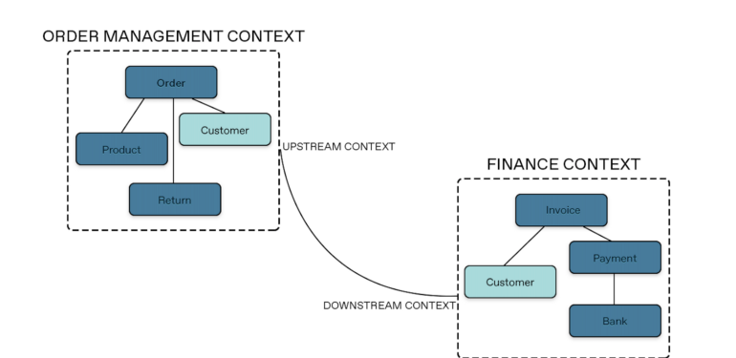

Slide 16
Collaborative Modeling
DDD proposes to model the domain effectively by doing a collaborative approach, involving all parties that hold not only technical, but business knowledge as well
Developers collaborate with domain experts with the intention of constantly refining the Domain Model, forcing them to learn important details and principles of the business problem they are trying to solve, instead of just producing code mechanically

Slide 17
Collaborative Modeling
To enable this collaboration between business and technical teams, the Domain Model should use a language that joins business with technical jargon, and finds a middle ground that all team members can understand and agree on, this is called a Ubiquitous Language to improve every interaction between tech and business teams, making the m less ambiguous and more effective.

Slide 18
Tactical Design
Domain Object (Entity)
Objects that have a unique identity and possess a thread of continuity
Domain Entity
Value Object
Objects that describe characteristics, and that do not possess any unique identity are called Value Objects, they care only about what they are, not who they are
Value Objects are attributes of, and can be shared by multiple entities
Value Objects must be immutable, forcing the system to replace them by fresh new instances, when an update is required

Slide 19
Tactical Design
Services
Services are classes that offer stateless operations.
Aggregates
Aggregates are collections of related Entities and Value Objects, clustered together representing a transactional boundary
No objects within the Aggregate can be called directly from the outside world, thus maintaining consistency within

Slide 20
Tactical Design
Repositories
an interface that hides the implementation details from the client, so that it does not depend on the infrastructure specifics, but merely on an abstraction.
provide an interface that the Domain Layer can use to retrieve stored objects, avoiding tight-coupling with the storage logic and giving the client an illusion that the objects are being retrieved directly from memory.

Slide 21
Isolation
DDD proposes a Layered Architecture as a way to separate concerns and avoid responsibility confusion by splitting the codebase in 4 main layers:
User Interface Layer: is responsible for displaying data and capturing user’s commands.
Application Layer: serves as an orchestrator of domain work, it does not know domain rules, but organizes and delegates domain objects to do their job. It is also the only layer accessible to other bounded contexts.
Domain Model Layer: holds the business logic and rules, as well as the business state. It is where the Domain Model lives.
Infrastructure Layer: implements all the technical functionalities the application needs to support the higher layers, persistence, messaging, communication between layer

Slide 22
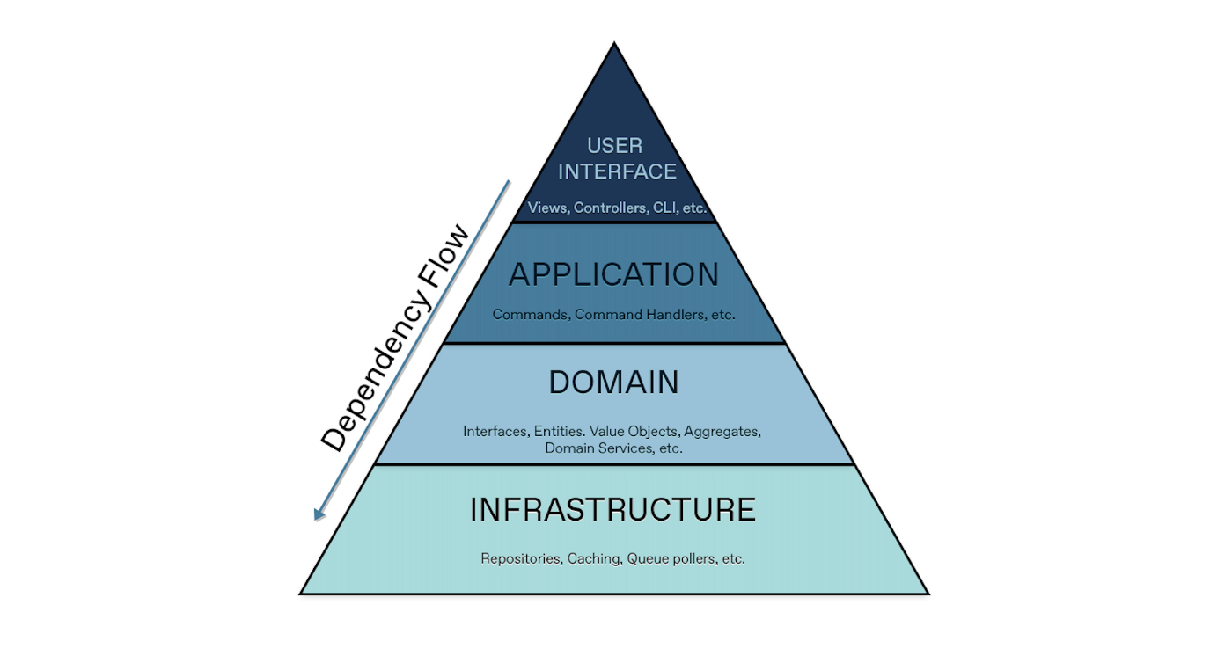

Slide 23

DDD-Microservices
. For the domain model for each Bounded Context, you identify and define the entities, value objects, and aggregates that model your domain.
Build and refine a domain model that is contained within a boundary that defines your context. And that is explicit in the form of a microservice.
The components within those boundaries end up being your microservices, although in some cases a BC or business microservices can be composed of several physical services. DDD is about boundaries and so are microservices.

Slide 24
Microservices Boundaries
Determining where to place boundaries between Bounded Contexts balances two competing goals.
First, you want to initially create the smallest possible microservices, although that should not be the main driver; you should create a boundary around things that need cohesion.
Second, you want to avoid chatty communications between microservices.
Cohesion is key within a single bounded context

Slide 25
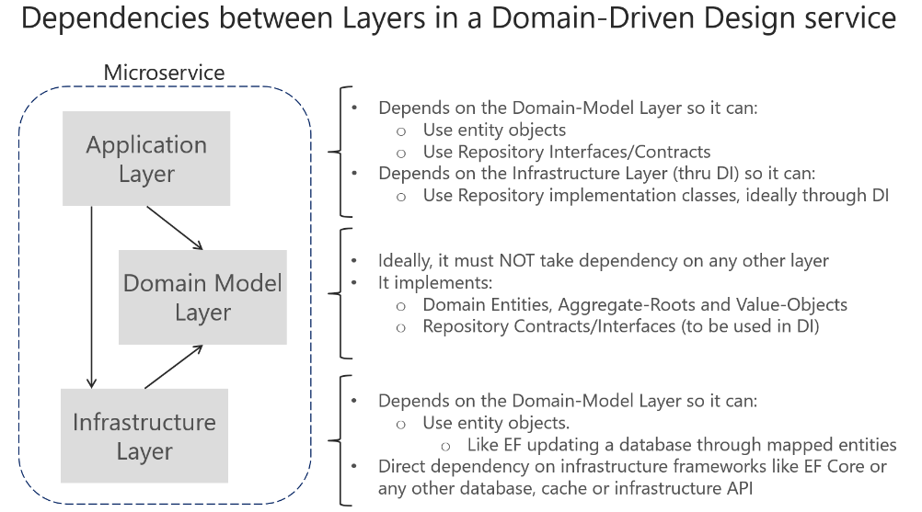

Slide 26
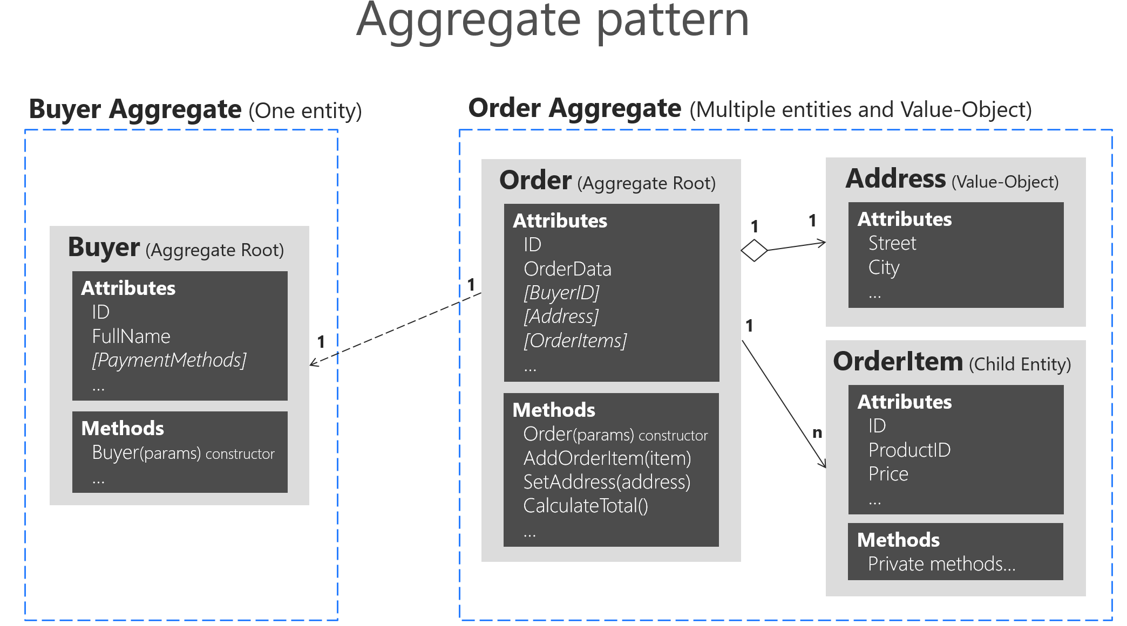

Slide 27
Domain Events
Use domain events to explicitly implement side effects of changes within your domain. In other words, and using DDD terminology, use domain events to explicitly implement side effects across multiple aggregates
A domain event should be used to propagate state changes across multiple aggregates within the same domain model.

Slide 28
